Slide 1
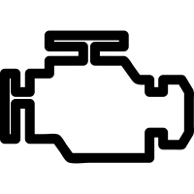
Cam-Less Engine
Control, Deviate, Stop
-M Ehsan -Aqdas Tariq -Usman Shoukat
Me-37-A

Slide 2
Problem
Full Engine Valve control
Valve opening time
Valve closing time
Valve Lift
Improvement in:
Fuel economy
Power production
Emissions Reduction
Engine weight
Engine size

Slide 3
Market Size
SAZGAR Engineering Works Limited (current potential buyer)
Toyota Pakistan
Honda Pakistan
Kia Motors Pakistan
Suzuki Motors Pakistan

Slide 4
Current Solutions
VVT
VVTI
V tech
Special Valves
Pneumatically Controlled
Hydraulically Controlled
Magnetic Levitation
Super Fluids

Slide 5
our Solution
Cam-Less Valve Control
Electronically controlled valve motion with the help of four bar mechanism
Full control over valve timing, lift and motion
Combustion in selective cylinders in multi cylindered engines

Slide 6
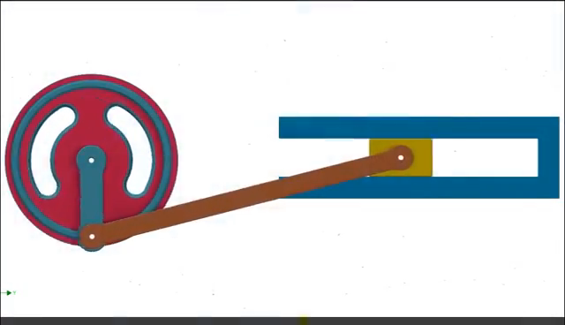
Features/Schematics
Servo motor
Four bar slider crank mechanism
Computer (ECU)
Sensors
Crank angle position sensor
O2 sensor

Slide 7

Why US!
Lowering of recurring cost
Saving the natural resources (Fuels)
Air pollution control
Emissions decreased
More power generation
Achievement of SDG

Slide 8
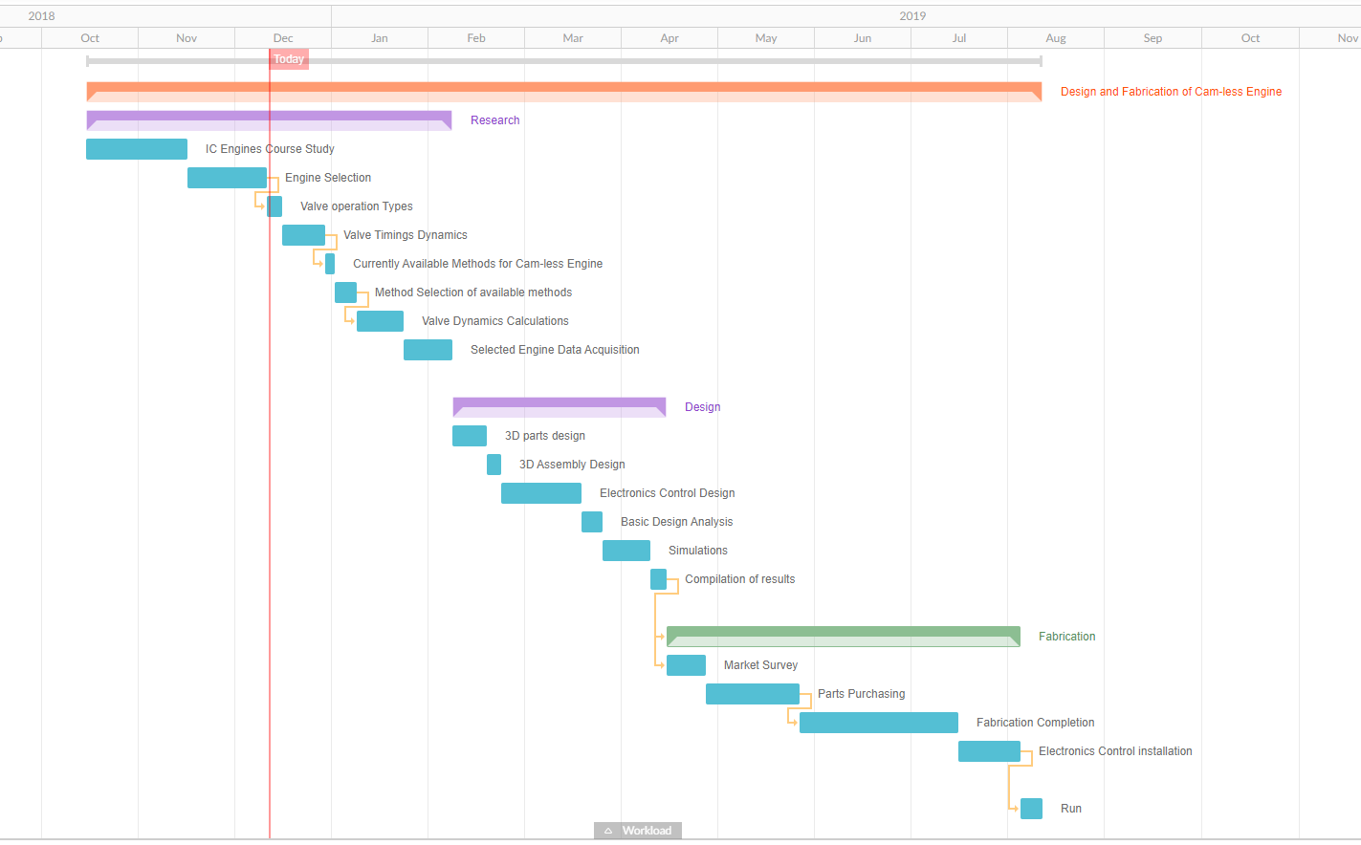
Timeline (Next 4 Months)

Slide 9
Timeline (future we look forward to)
Experimental Implementation on smaller engine
Implementation on single cylinder engines Implementation on Multi cylinder engines used in domestic use vehicle
Higher grade vehicle engines (Military grade)
August, 2019
Year
2021
NYD

Slide 10
Thank You!

